Slide 1
A Successful Approach to Off-Hosting SAS/MXG Processing Session #22526
Colleen Gordon, Luminex Software
Paul Massengill, Luminex Software
Chuck Hopf, Merrill Consultants

Slide 2
Introductions
Chuck Hopf
Independent Computer Software Professional
36 years supporting MXG
40 years performing Computer Measurement and Capacity Planning
Works with Lifewaters, diving with disabled veterans
Paul Massengill
Recently joined Luminex as an Sales Engineer (lucky for us)
20 of years supporting Storage and Virtual Tape sales at STK, HDS, Oracle, etc.
7 years in Storage Mgmt and Capacity Planning at Wachovia and Bank of America
Works with Wounded Warrior Project and Disabled Veterans

Slide 3
Client Environment
Large mainframe client in the US
Up to 12 TB of SMF data processed daily during peak retail period
Approximately 8 TB of SMF data on a daily basis
CICS, DB2 and everything else (MVS)
30+ LPARS
Process approximately 1.2 – 1.6 TB of SMF data every 4 hours
PDBs are used by Data Analysts for business insights as soon as available
MXG processing is staggered 15 minutes apart to manage system resources
Time to process currently is 3.5 – 4 hours
Capacity Management reporting is executed every 4 hours or 6x per day

Slide 4
Client Environment (continued)
SAS code for reporting created decades ago
Hundreds of SAS reports that run every day
Many different authors
Many years of “enhancements”
Difficult for client to maintain current SAS environment
Too much time spent investigating/resolving issues
Difficult to bring new team members up to speed

Slide 5
Client’s Objectives
To maximize mainframe system performance reporting and trending capabilities, the following objectives needed to be achieved:
Eliminate and/or minimize overhead costs on the mainframe
Reduce mainframe software costs wherever possible
Reduce latency for mainframe reporting and Data Analytics
Currently 3.5 – 4 hours
Simplify SAS Language code and reduce the maintenance burden on support staff
Redirect staff time and expertise to other strategic and revenue generating projects

Slide 6
Solution Testing
Luminex Mainframe Data Integration SAS Language Processor (MDI:SLP)
Hardware and Software solution executing on mainframe and Linux platform
Linux platform with 16 cores and 389 MB of RAM
Redundant FICON cards
Mainframe interface
MXG ASCII version
No additional cost to MXG clients
WPS (SAS Language Compiler) licensed on Linux Platform
Can also support SAS Institute license

Slide 7
Solution Benefits
MDI:SLP solution from Luminex
Off-host processing frees up mainframe processing cycles for other critical workloads
Mainframe remains the “system of record”
SMF/PDB scheduling, SYSOUT reporting and problem reporting
Graphics rendering is better on the Linux server and can be distributed from there
More concurrency of job executions since no longer on MSU constrained mainframe
MXG ASCII Version
MXG Macros streamline processes
100 lines of SAS code reduced to 18 lines using MXG Macros
WPS ease-of-use with Eclipse based WPS Workbench
Allows for a new generation of non-mainframe programmers
Opportunity to enhance using new languages – ex. R & Python
AD Hoc reporting done directly on Workbench

Slide 8
Client’s POC Objectives
Demonstrate MXG PDB build process on MDI:SLP
Stress test of running 4 hour PDB build for 12 LPARs on one MDI Platform
Convert and execute 10 SAS reports chosen by client
Client choose 10 of the most complicated reporting jobs
Created a major hurdle!
Over 300 jobs had to be created to stage the data on the MDI Platform for the reports to be executed
More on this later…
Improve the latency of data availability
Reduce from 3.5 – 4 hours to less than 2 hours

Slide 9
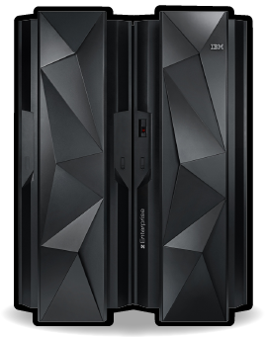
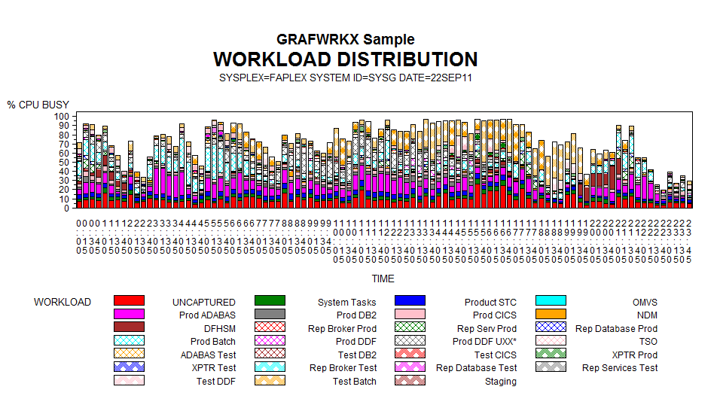
MDI:SLP SMF Processing – Final State
FICON
MDI
1 or 10 GbE
Storage for SMF Data
LUMXPROC
SLP Code
WPS / SAS
Reports
Storage for PDB Data
MXG Code
Mainframe
Sends SMF data to MDI
MDI Platform
Receives SMF data
Builds PDBs
Execute Reports
Optionally sends reports and PDBs back to Mainframe
Open Systems Storage
SMF data on virtual tape
PDBs
Report Output
Reports sent to SQL database

Slide 10
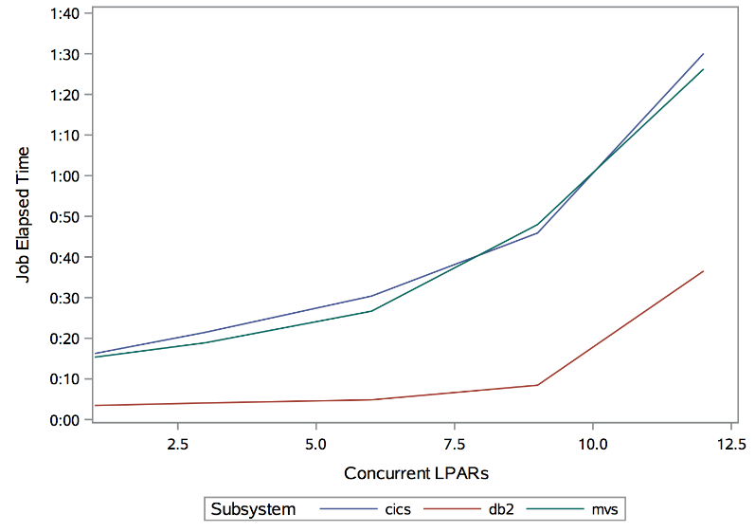
POC Accomplishments: PDB Build Stress Test
Off-host PDB build of 12 LPARs and 36 PDBs
Total SMF data processed by a single MDI platform > 1 TB
Test consisted of 12 of the largest LPARs and was run on a single MDI
“Knee” of curve identified after 3-6 LPARs or approximately 600 GB of SMF data
LPAR 6
LPAR 12
CICS
DB2
MVS
Total Storage > 1TB
~600 MB/sec throughput to storage

Slide 11
POC Accomplishments: SAS Reports
SAS jobs were successfully converted to run with MDI and WPS
WPS executes the SAS code for the reports completely off host on the MDI platform
JCL and SAS code was converted to invoke the MDI LUMXPROC to pass data and parameters to the MDI Platform
Job was converted TWO ways:
MDI only
JCL to MDI
ProdJOB
JCL
Calls LUMXPROC
LUMXPROC
Report Results returned to mainframe
SASLOG and SASLST returned to mainframe
MDI:SLP
SAS/MXG report is run against the PDBs on MDI
PDBs
Circas.sas

Slide 12
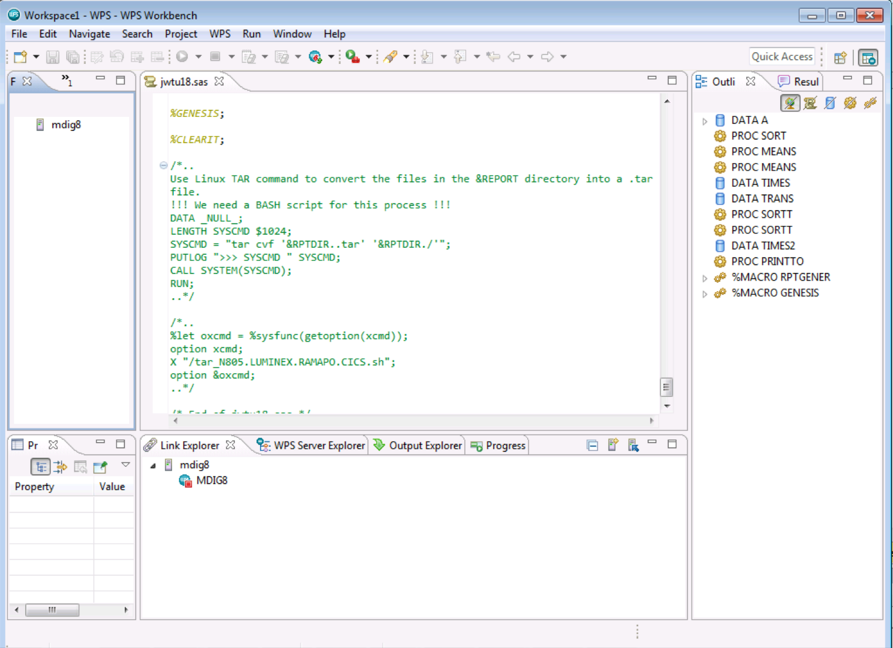
WPS Workbench
WPS Workbench proved to be a major upgrade for this client
Based on Eclipse IDE that is very familiar to recent hires
Enables R and Python integration with SAS
Client can create/execute ad-hoc reports straight from the Workbench on their desktop
No need to go through mainframe to execute reports

Slide 13
Optimization Opportunities During Migration
We found many ways to optimize the client’s SAS code
Corrected incorrect calculations (average of averages)
Client found optimized code to be simpler and easier to maintain
Reduced 100s of lines of SAS code into 18 lines using MXG macros
SAS code converted to MXG Macros now supported by MXG
We found many jobs that can now be removed from production
Allow MXG to maintain the trending databases
Reduced multiple efforts to maintain trends
Greatly simplified support
Standard fields for all reports makes report jobs easier

Slide 14
POC Results
Results of POC
Test 0 is for identical job running on z/OS
In one case for Test 0 the data was too large to be handled on a single volume so the second largest LPAR was used as well

Slide 15
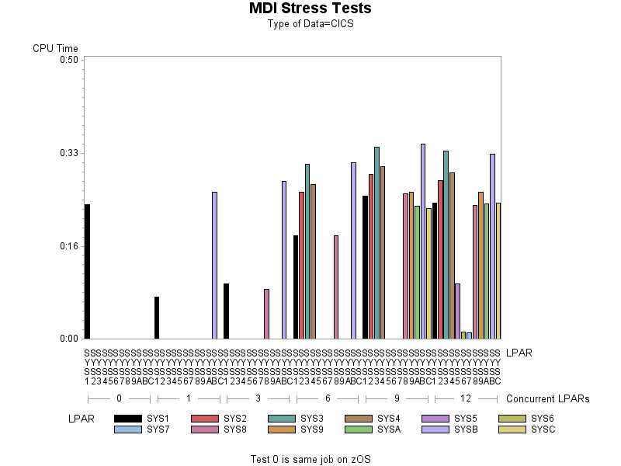
CICS Tests – CPU Time
z/OS
MDI:SLP Platform
Test 0
Test 1
9 jobs for 3 LPARs
18 jobs for 6 LPARs
27 jobs for 9 LPARs
36 jobs for 12 LPARs

Slide 16
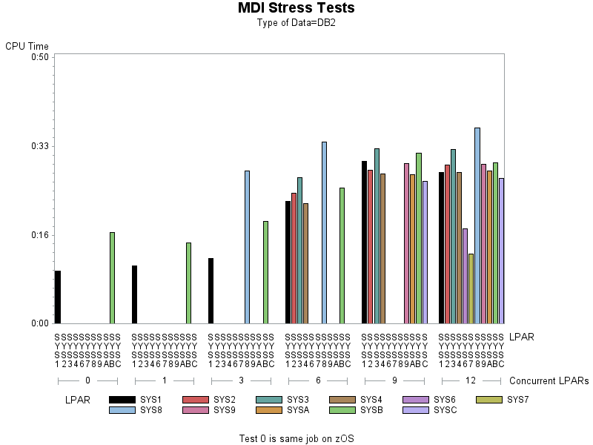
DB2 Tests – CPU Time
z/OS
MDI:SLP Platform
Test 0
Test 1
9 jobs for 3 LPARs
18 jobs for 6 LPARs
27 jobs for 9 LPARs
36 jobs for 12 LPARs

Slide 17
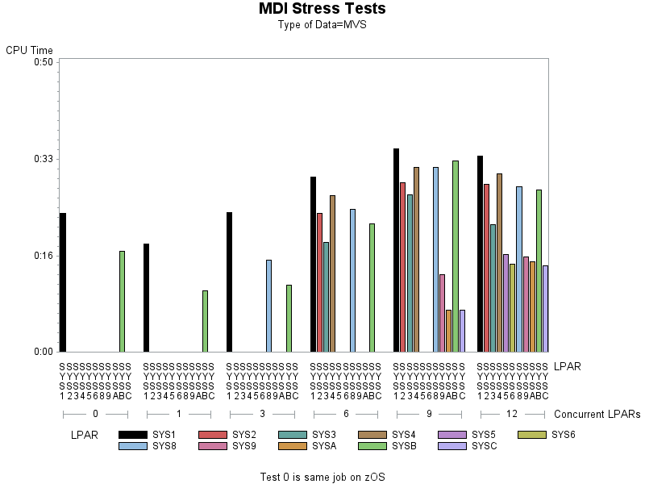
MVS Tests – CPU Time
z/OS
MDI:SLP Platform
Test 0
Test 1
9 jobs for 3 LPARs
18 jobs for 6 LPARs
27 jobs for 9 LPARs
36 jobs for 12 LPARs

Slide 18
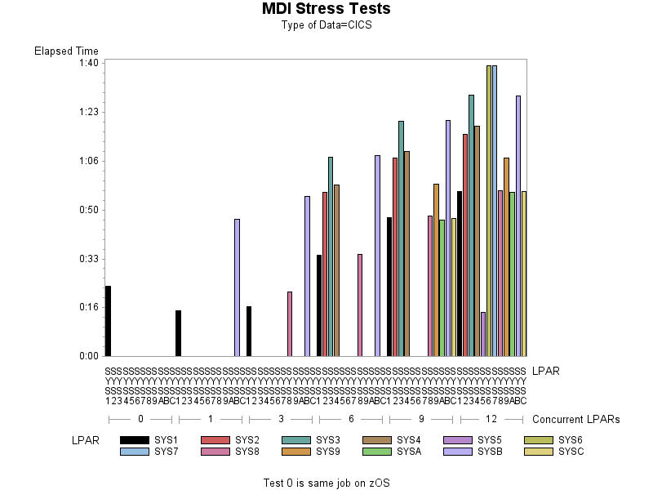
CICS – Elapsed Time
z/OS
MDI:SLP Platform
Test 0
Test 1
9 jobs for 3 LPARs
18 jobs for 6 LPARs
27 jobs for 9 LPARs
36 jobs for 12 LPARs

Slide 19
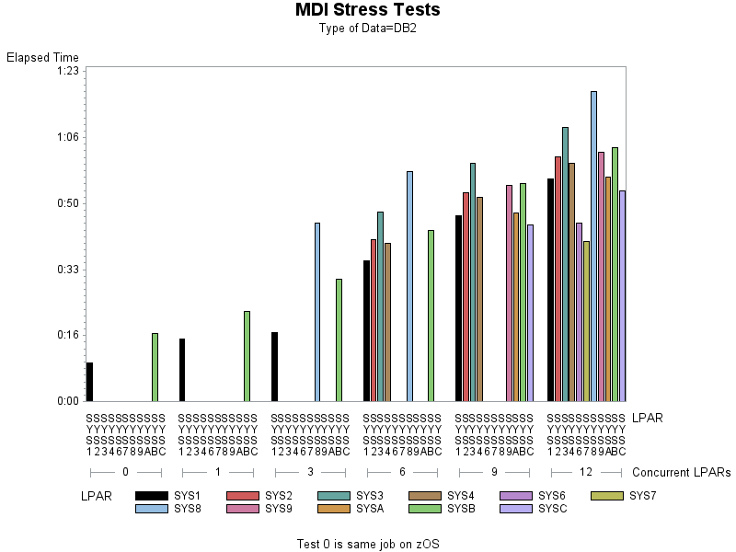
DB2 – Elapsed Times
z/OS
MDI:SLP Platform
Test 0
Test 1
9 jobs for 3 LPARs
18 jobs for 6 LPARs
27 jobs for 9 LPARs
36 jobs for 12 LPARs

Slide 20
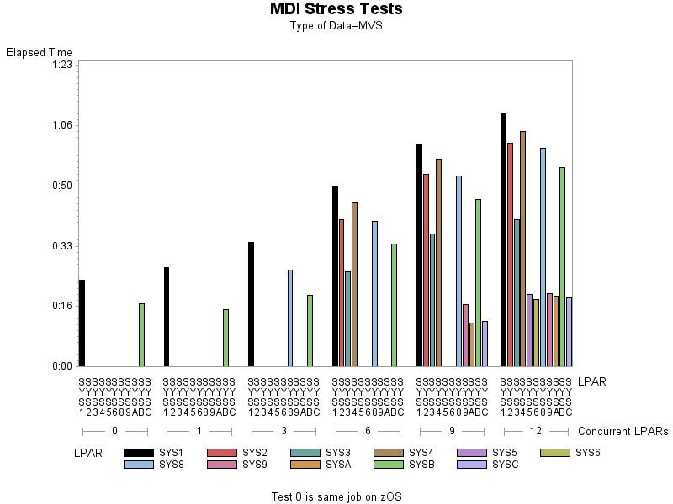
MVS – Elapsed Times
z/OS
MDI:SLP Platform
Test 0
Test 1
9 jobs for 3 LPARs
18 jobs for 6 LPARs
27 jobs for 9 LPARs
36 jobs for 12 LPARs

Slide 21
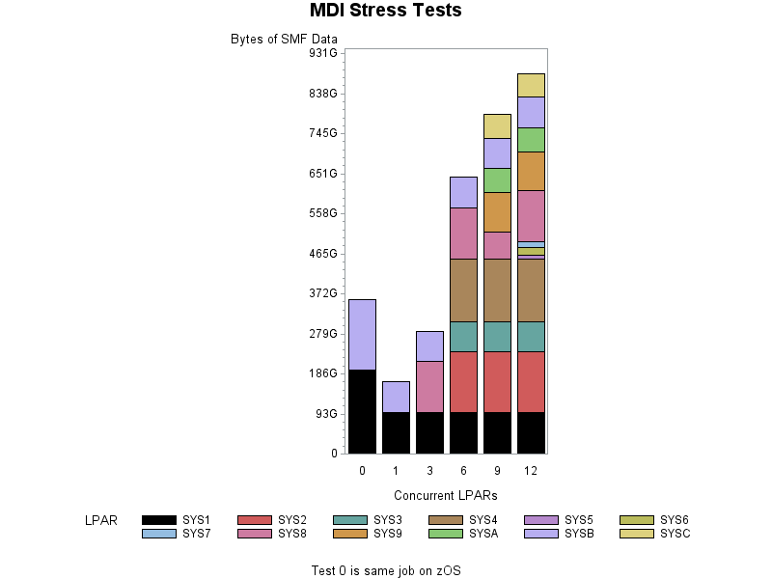
Data Bytes by System

Slide 22
Data Bytes by Type of Data

Slide 23
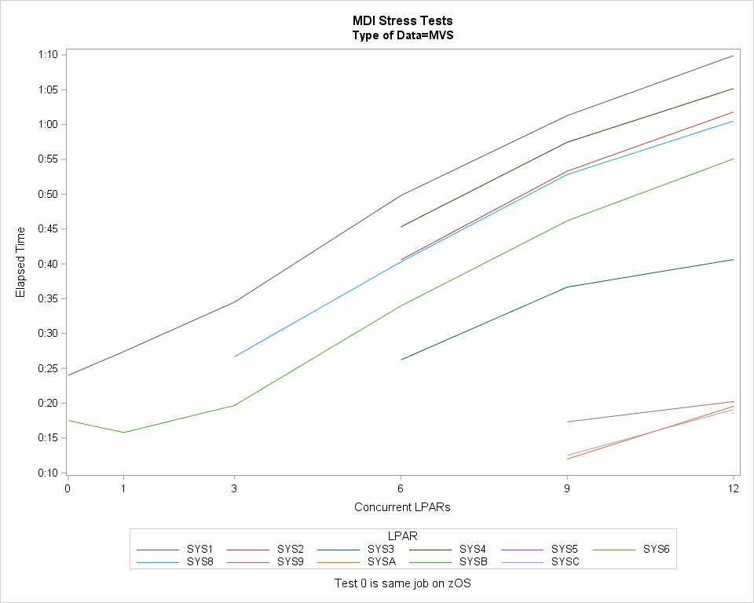
Elapsed Times ‘Knee of the Curve’

Slide 24
JCL to Run BUILDPDB on MDI
//STEP10 EXEC LUMXPROC,PROFILE=&PROFILE
//*
//* -PARM EXECUTES PROGRAM STORED ON MDI SERVER
//*
//XPROCLOG DD SYSOUT=*
//*
//SMF DD DSN=&SMF, INPUT
// DISP=OLD,UNIT=&UNIT
//* LIST IS THE REPORT OUTPUT
//SASLIST DD DISP=(,CATLG),DSN=&SASLIST,
// DCB=(LRECL=255,RECFM=VB,BLKSIZE=0),
// UNIT=&UNIT
//* LOG IS THE CODE EXECUTION OUTPUT
//SASLOG DD DISP=(,CATLG),DSN=&SASLOG,
// DCB=(LRECL=255,RECFM=VB,BLKSIZE=0),
// UNIT=&UNIT
//*

Slide 25
JCL to Run BUILDPDB on MDI (part 2)
//*SYSIN IS VERY CASE SENSITIVE - and names of programs must match
//*names of SASLOG SASLIST DDs
//SYSIN DD *
-PARM slp_program=/luminex/storage/CUST/mxg/userid/mdipdb.sas
;
-DD_SASLOG=mdipdb.log oformat=ebcdic_NPC;
;
-DD_SASLIST=mdipdb.lst oformat=ebcdic_NPC;
;
-DD_SMF=mdipdb.smf;
/*

Slide 26
Code to Run Daily/Weekly/Monthly/Trend Jobs
%utilbldp(useradd=42 6156,buildpdb=yes,outfile=instream);
%bldsmpdb(buildpdb=instream,
autoaloc=yes,
basedir=/luminex/mxg/,
datefmt=yymmdd,
runday=yes,runweek=yes,runmnth=yes,runtrnd=weekly,
day2keep=31,cicskeep=14,db2keep=14,wek2keep=26,
mth2keep=48
);

Slide 27
Lessons Learned
CICS data for test 1 exceeded the capacity of a 3490 tape so the second largest system was substituted.
Always define at least some 3590 drives
Modify SLP to handle multi-volume tape inputs
Each job uses 3 tape drives/tapes so there must be plenty of scratch tapes available 12*3=36 jobs times 3 tapes is 108 tape drives and 72 scratch tapes
Time to learn at least a bit about LINUX

Slide 28
Conclusions
Client was very impressed by the performance of the MDI:SLP Platform
PDB builds reduced from 3.5 – 4 hours to under 2 hours
Allows client to grow without impacting mainframe 4-hour rolling average
Client loves the WPS Workbench
Allows non-mainframe analyst to support capacity reporting
Client excited to capitalize on code optimization/modernization
Ease of support for years to come
Some code converted to macros now supported by MXG
Interested in code enhancements being written in R and Python

Slide 29
Q&A

Slide 30
Thank You!
Evaluate this session:
Paul Massengill: pmassengill@luminex.com
Chuck Hopf: chuck@mxg.com

Slide 31
The Race to 15,000!
PERSON
PROGRAM
PROJECT
Complete your session evaluations at www.share.org/evaluation
and see your progress on the leaderboard!
Notes:
Please include this slide at the end of your presentation!

