Slide 1
Who is Using all the MSUs

Slide 2
ANALMSUS
A new MACRO that will let you drill down into the hourly MSU usage at the:
    Type 89 level
    CEC level from ASUMCELP
    TYPETASK SRVCLASS RPTCLASS JOB levels from SMFINTRV
Can produce bar charts, tabular reports and optionally EXCEL speadsheets
Can read SMF data or pull data from an existing PDB
Creates output datasets that can be used for further analysis

Slide 3
ANALMSUS
Exits to tailor data
INCODE89 INCODECELP INCODESMFI
INCODETASKS INCODESRV INCODERPT
INCODEJOBS
Parameters to select date ranges
  FROMDATE – SAS date values (01MAY19)
  TODATE

Slide 4
ANALMSUS
CHART/TABULATE parameters with a default of ALL let you decide which reports you want to see
SUPPRESS lets you completely SUPPRESS one or more of the sections

Slide 5
ANALMSUS
Example of usage (there are more in the DOC in the member).
/* Example 1: */
/* Create PDF output and EXCEL spreadsheets for all limiting jobs */
/* to those that consumed more than 2 MSU read data from PDB and */
/* put output datasets in PDB */
/* */
/* WINDOWS: */
/* ODS PDF FILE='D:\ANALMSUS.PDF'; */
/* ANALMSUS(READSMF=NO,TABULATE=YES,EXCELDEST=D:\, */
/* INCODEJOBS=IF MSU GT 2;); */
/* ODS PDF CLOSE; */
/* */

Slide 6
ANALMSUS
Example of usage (there are more in the DOC in the member).
/* Example 1: */
/* Create PDF output and EXCEL spreadsheets for all limiting jobs */
/* to those that consumed more than 2 MSU read data from PDB and */
/* put output datasets in PDB */
/* */
/* LINUX: (remember case is sensitive) */
/* ods pdf file='/mxg/analmsus.pdf'; */
/* ANALMSUS(READSMF=NO,TABULATE=YES,EXCELDEST=/mxg/, */
/* INCODEJOBS=IF MSU GT 2;); */
/* ODS PDF CLOSE; */

Slide 7
ANALMSUS
Example of usage (there are more in the DOC in the member). NOTE: on zOS EXCEL files must go to an HFS/zFS directory.
/* Example 1: */
/* Create PDF output and EXCEL spreadsheets for all limiting jobs */
/* to those that consumed more than 2 MSU read data from PDB and */
/* put output datasets in PDB */
/* */
/* ZOS: (case is sensitive here as well) */
/* ods pdf file='/u/mxg/analmsus.pdf'; */
/* ANALMSUS(READSMF=NO,TABULATE=YES,EXCELDEST=/u/mxg/, */
/* INCODEJOBS=IF MSU GT 2;); */
/* ODS PDF CLOSE; */

Slide 8
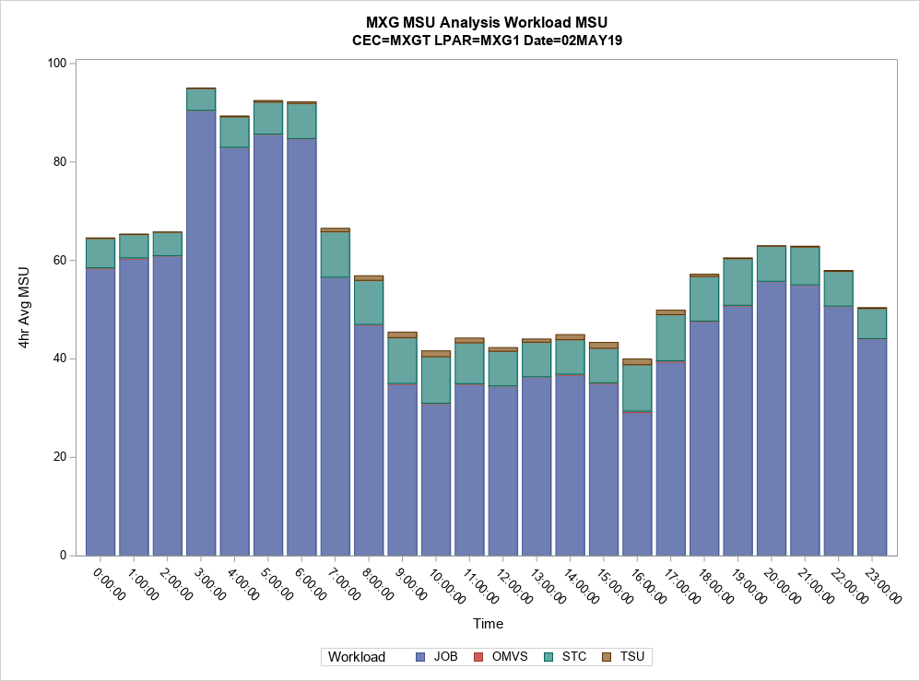
ANALMSUS
Sample outputs:

Slide 9
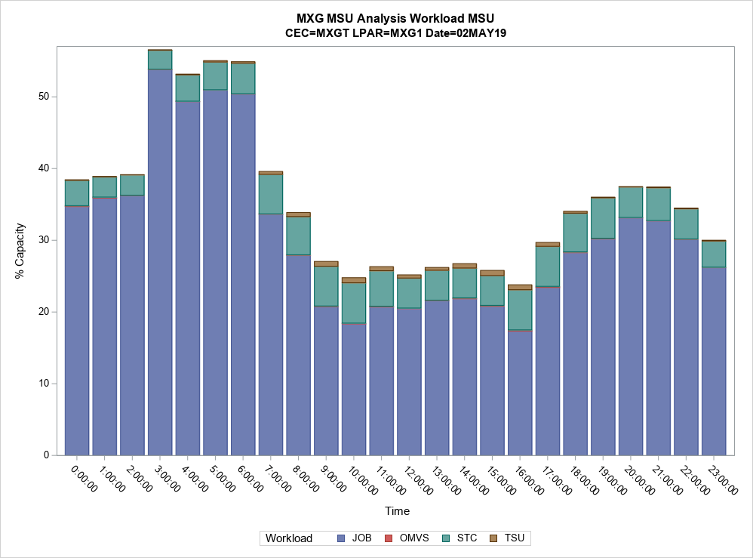
ANALMSUS

Slide 10
ANALMSUS
A full set of sample output is on the download site as ANALMSUS.ZIP

